Slide 1
CS2033a/b Lecture 4 All About Forms Vivi Tryphonopoulos

Slide 2
LECTURE #4 OVERVIEW
Understanding:
What is a Form ?
What Forms Offer - case scenarios, redesigns
Form organization
how long should a form be?
Effects on a mobile device
labels, input fields, structure,layout
Form interactions – signing up
Moving beyond Static Forms – giving people feedback instantly, device capabilities
What makes Web Forms Tick!

Slide 3
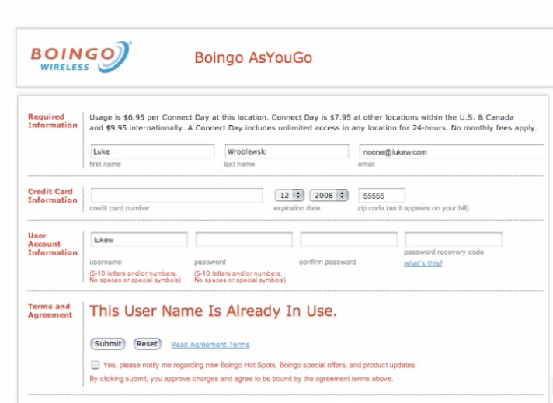
WEB FORMS – What Forms Offer
Web forms allow us to communicate for a service or a product that we are interested in

Slide 4
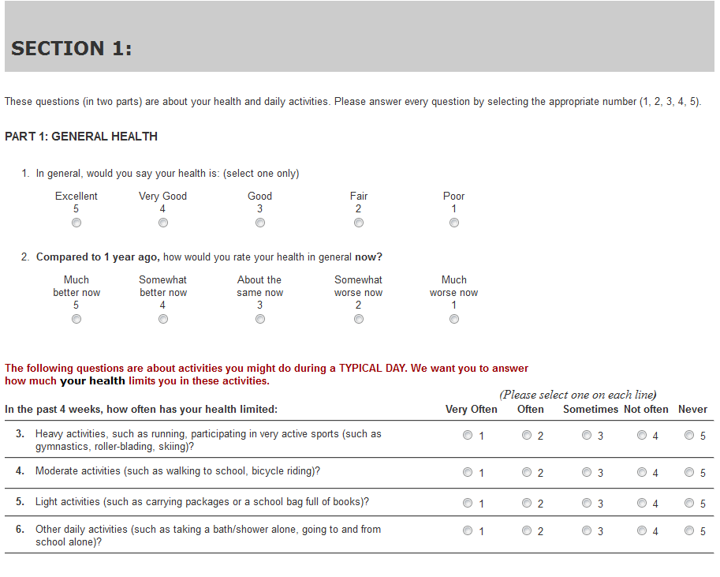
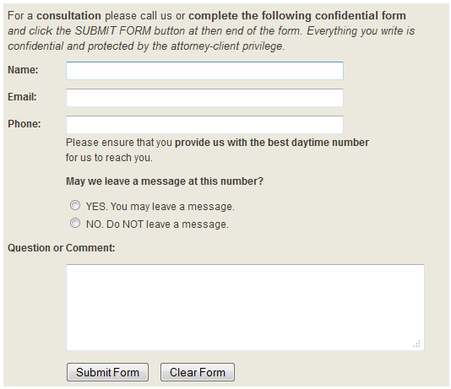
WEB FORMS – What Forms Offer
Web forms allow us to communicate for a service or a product that we are interested in

Slide 5
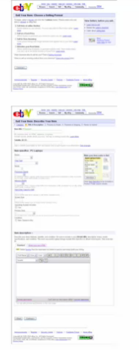
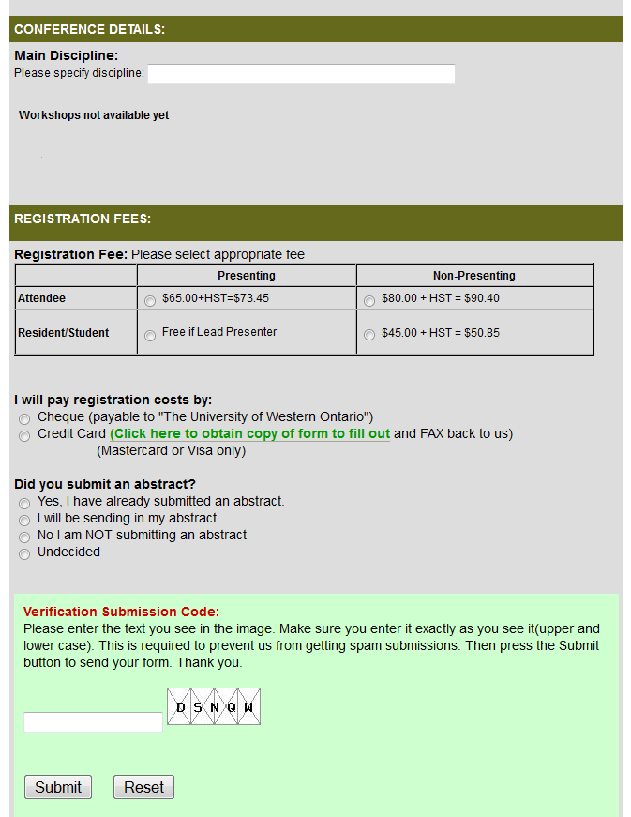
WEB FORMS – What Forms Offer
Case Scenario: ebay
They are selling marketplace
E-Bay is 30th largest economy in the world
700,000 people making a living on ebay
$8,000 of goods processed per second
Case Scenario: Conference Registration
Trillium Research Day
Capturing Registration Details
Abstract Submissions Online
Form Submission validation with Captchas

Slide 6
WEB FORMS – What Forms Offer
On the Internet: There is always a web form involved online for something we want - something of value for us
But What’s in it for the companies?
Consider the following sites:
Commerce: Increased Purchases -> maximizing sales
Social: Participating, growing communities -> 3rd party ads
Productivity: Increased manpower, product offering managing info, selling services.
Webform is always involved!
And Design is very important!

Slide 7
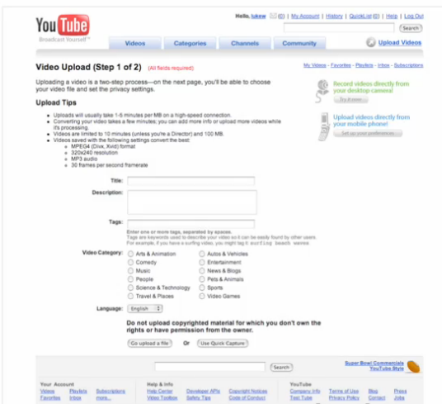
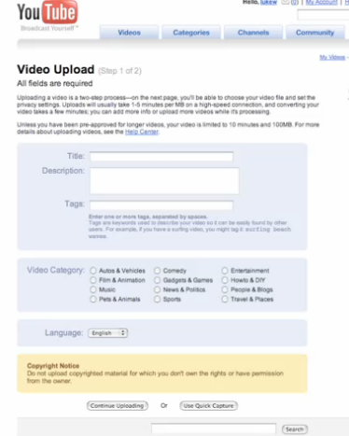
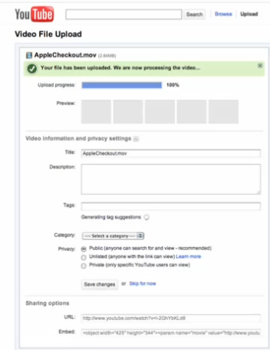
WEB FORMS – What Forms Offer
Consider YouTube’s redesign
Web form is always involved.
And design is very important! Why the change?

Slide 8
WEB FORMS – What Forms Offer
After YouTube’s redesign
Year | #of Videos Upload/day
2006 | 65,000
2007 | 172,000
2009 | 518,000
2010 | 756,000
2011 | 1,036,000
Results:
Audience grew
So YouTube paid attention to detail on their forms - fine tuned
Form redesign leads to impact and met their needs
BUT NOT at the expense of the customer

Slide 9
WEB FORMS – What Forms Offer
Redesign for New Trends
Recognizing applications are accessed From desktop/laptops to Mobile Devices
Increasing use of devices to get things done
Commerce:
Amazon: over $1 billiion spent via mobile devices in 2010
Best Buy mobile Web users doubling every year: 30M (2010), 17M (2009) 6M (2008)
Social: (recognizes new posts)
Twitter: 16% of all new users start on mobile, 40% of new posts
Facebook: 250 million active mobile users, 33% of new posts
Productivity:
Email activity is 41% of US mobile Internet time
70% of smartphone users have accessed Email on their mobile devices
Thus Form Design Matters!
Source: http://www.lukew.com/ff/entry.asp?1678

Slide 10
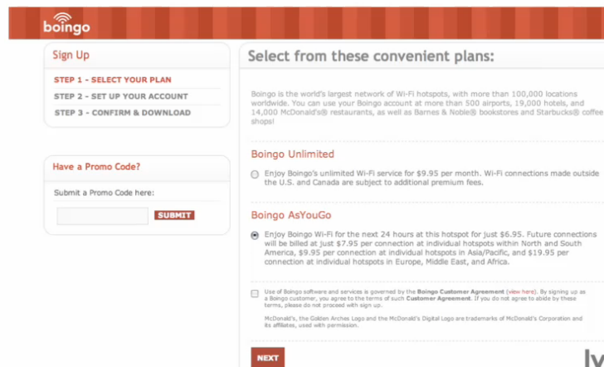
WEB FORM ORGANIZATION
Form Length:
How long should a form be?
Boingo redesigned from a 1 page solution → Multipage solution
Source: http://www.lukew.com/ff/entry.asp?1678

Slide 11
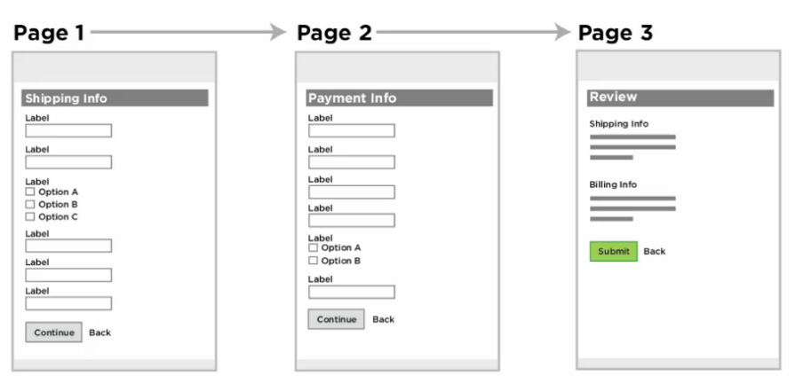
WEB FORM ORGANIZATION
Testing was done
Is the drop off rate higher with a longer form than breaking it up into multiple pages ? Same form.. Different variations
Variation 1: Multiple Pages
Source: http://lynda.com

Slide 12
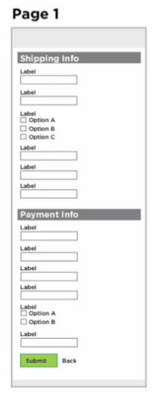
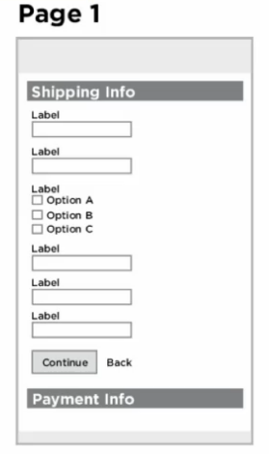
WEB FORM ORGANIZATION
Testing was done
Variation 2: 1 long page
Variation 3: Using Expandable and Collapsing sections
Source: http://lynda.com

Slide 13
WEB FORM ORGANIZATION
Results:
Conclusion:
Did not impact
So what does?
1 long page
Using Expandable and Collapsing sections
Source: http://lynda.com

Slide 14
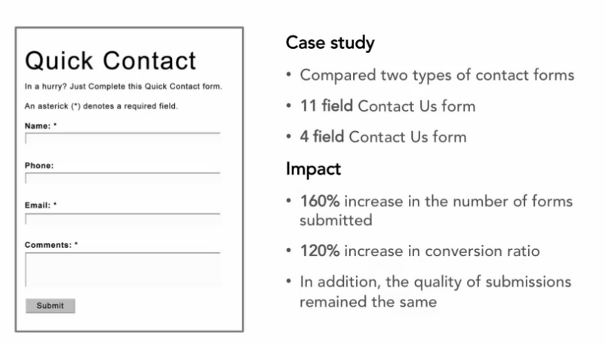
WEB FORM ORGANIZATION
CASE STUDY
What Made the Difference?
Giving people speed and ease (shorter form)
Removed fields
Does it have to be there?
Source: http://lynda.com

Slide 15

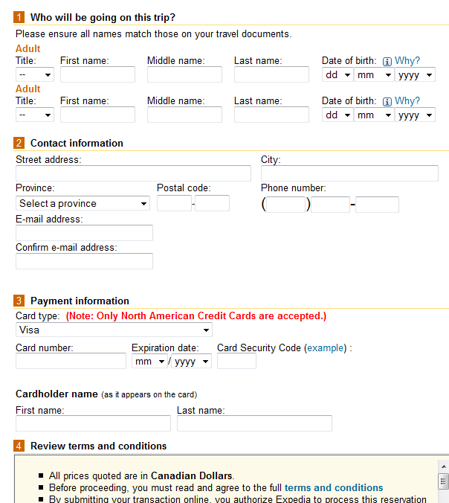
WEB FORM ORGANIZATION
CASE STUDY
Case Study:
Customers who clicked Buy Now did not complete the transaction
Why?
Form had an optional field under Name titled “Company”
→ Led to lost sales
What did they do to change this
Removed Company field
$12 m of profit a year overnight
Source: http://lynda.com

Slide 16
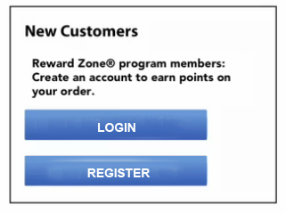
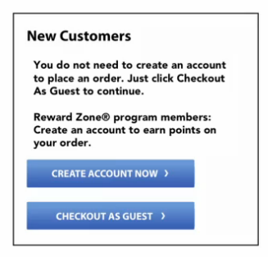
WEB FORM ORGANIZATION
Big Box Retailer
CASE STUDY – Big Box Retailer
What is the perception here?
Possible to purchase without an account
What did they Change?
Changed to button to ”You do not need to create an account to buy” message
45% increase purchasing customers
$1.5M increase in first month
$300M increase in first year
Source: http://lynda.com

Slide 17
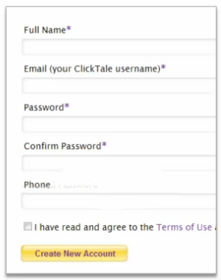
WEB FORM ORGANIZATION
CASE STUDY – Big Box Retailer
What did they do?
Added optional on phone #
Why?
Many don’t want that information passed on
Source: http://lynda.com

Slide 18
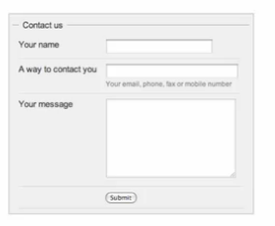
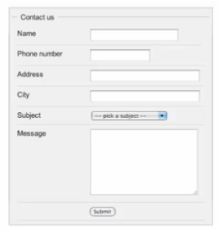
WEB FORM ORGANIZATION
How a form can quickly change in an organization
Simple form
Source: http://lynda.com

Slide 19
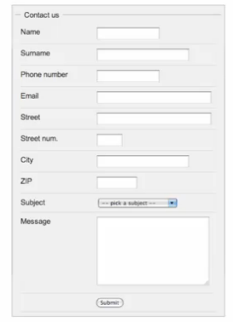
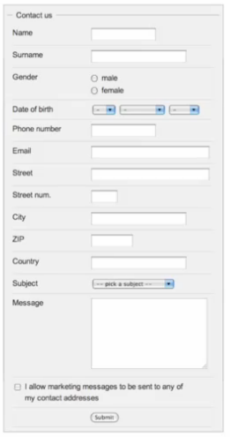
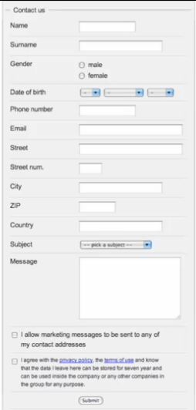
WEB FORM ORGANIZATION
How a form can quickly change in an organization
Engineering Group
Marketing Group
Legal Group
Source: http://lynda.com

Slide 20
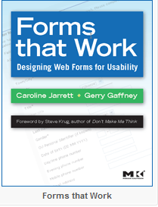
WEB FORM ORGANIZATION
Forms have to communicate with one voice
KEEP, CUT, or POSTPONE
KEEP- Stick with fields you HAVE to have
CUT– Get rid of things not necessary
POSTPONE– defer asking questions until a later time
Caroline Jarrett
http://www.formsthatwork.com/
Source: http://lynda.com

Slide 21
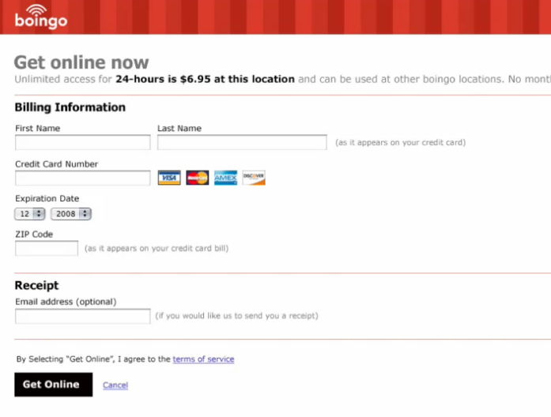
WEB FORM ORGANIZATION
Forms have to communicate with one voice
KEEP, CUT, or POSTPONE
A Different Take on redesigning Boingo
Trim down the steps
Name
How are you paying
Source: http://lynda.com

Slide 22
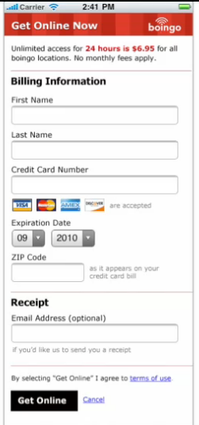
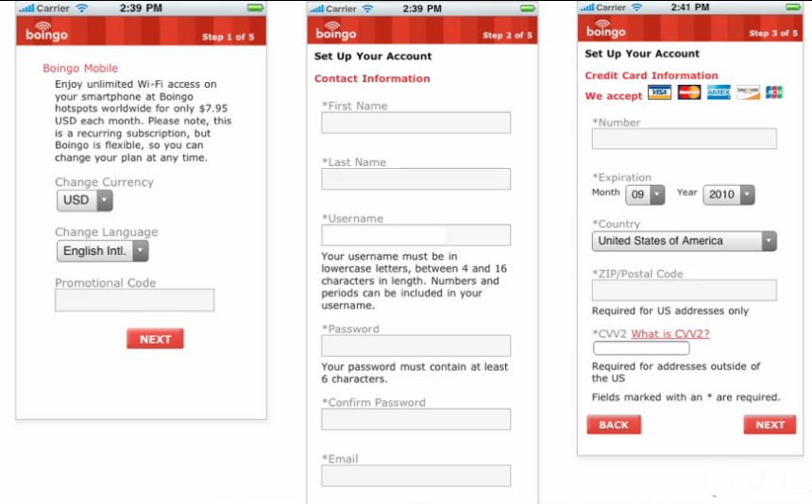
WEB FORM ORGANIZATION
Boingo’s original on a mobile device spanned over a series of 5 pages ... Thus need change to simplify
Redesigned into 1 page
Source: http://lynda.com

Slide 23
WEB FORM ORGANIZATION
Summary on Form Length:
Review all questions you need to ask (needed?)
If a form naturally breaks down into a few short topics, use a single webpage
Multiple pages help with organization .. But removing fields has impact
When a form contains a large number of questions related to a single topic , use one long web page
If form contains a large number of questions that are related by a few topics, try multiple pages
Source: http://lynda.com

Slide 24
WEB FORM - STRUCTURE
Form Structure
Sequential
Non-Linear
In-Context
How do people navigate through forms?
Consider desktop, laptops, ipads, mobiles
Source: http://lynda.com

Slide 25
WEB FORM - STRUCTURE
Form Structure
Let’s consider mobile device
Sequential
Groups of questions that have to be asked to complete a task
Go through each question in turn modifying
Examples
Registration
Checkout
Anything requires answers
Source: http://lynda.com

Slide 26
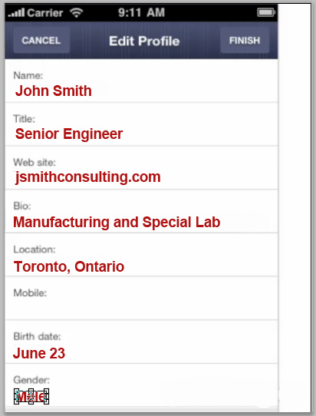
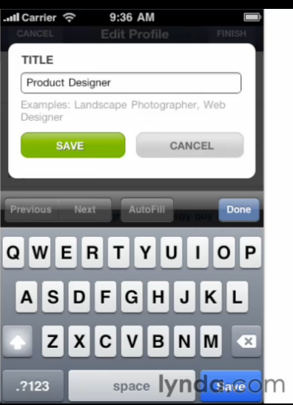
WEB FORM - STRUCTURE
Form Structure on Mobile Devices
Non-Linear
No need to go through each field
Input can be separately modified.
Each possible input can be selected and edited in a separate screen or dialog
Get the person to the information they want to modify/remove quickly and easily
Focus: on finding exactly what you need to change directly
Source: http://lynda.com

Slide 27
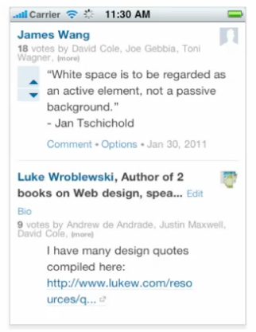
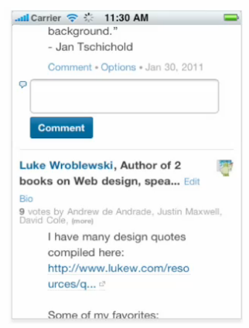
WEB FORM - STRUCTURE
Form Structure on Mobile Devices
In-Context
Provide a way to quickly contribute or create without a lot of effort
Feature of inline (direct) expands
Applies to those who want to contribute fast! And directly!
Contributing directly with one simple touch (direct inline editing)
Source: http://lynda.com

Slide 28
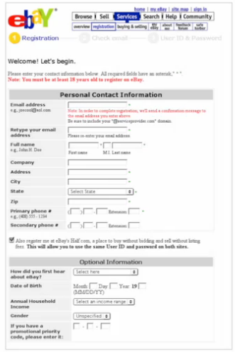
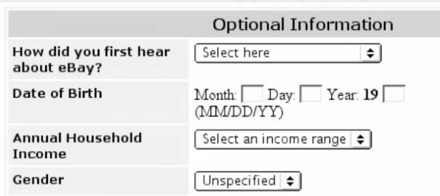
WEB FORM - STRUCTURE
Removing Unnecessary Information
In 2003 Ebay had standard questions:
And then moved you into the Optional Questions
What Happened?
Key point of drop off in this form
Intrusive?
Source: http://lynda.com

Slide 29
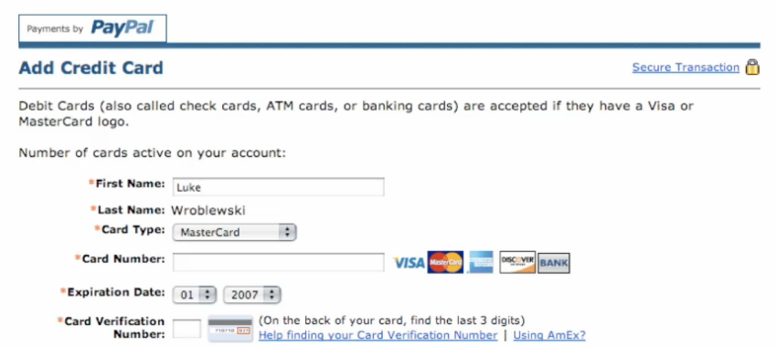
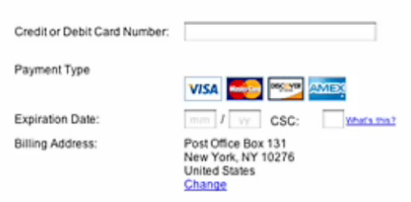
WEB FORM - STRUCTURE
Removing Unnecessary Information
PayPal redesigned:
The moment the card# is entered
Payment type is recognized.
Ie. Begins with “42” - Visa
“5” - Mastercard
“3” - American Express
“6” - Discover
http://en.wikipedia.org/wiki/Bank_card_number
Source: http://lynda.com

Slide 30
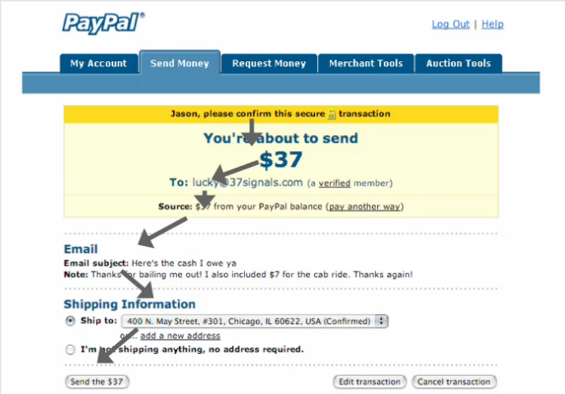
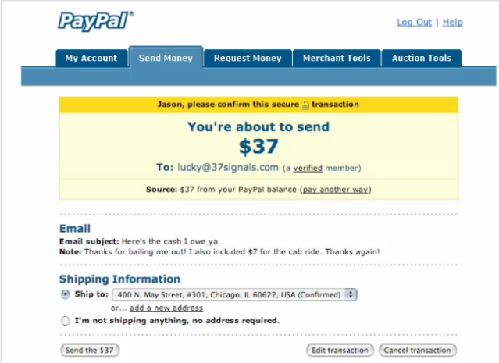
WEB FORM - STRUCTURE
Layout of Forms – Path to Completion
Clear Path to Completion:
Easy to understand ?
Easy to Follow?
Source: http://lynda.com

Slide 31
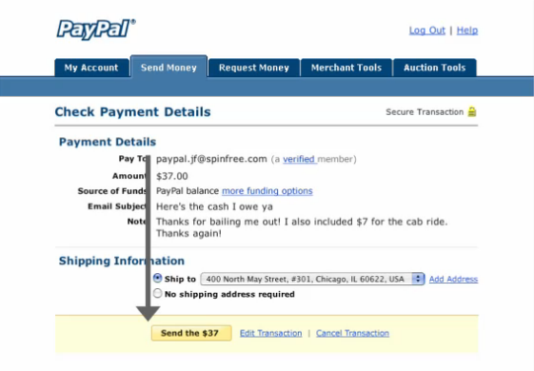
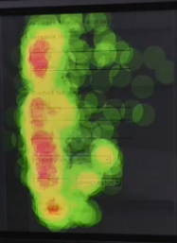
WEB FORM - STRUCTURE
Layout of Forms – Path to Completion
Clear Path:
Straight linear path
See yellow button
Aligning input fields to show start to finish
Let them know where they are in the ________
Eye Tracking Facts
Red: Areas gaze _____
Green: Areas ______
→Eye Fixation
Source: http://lynda.com

Slide 32
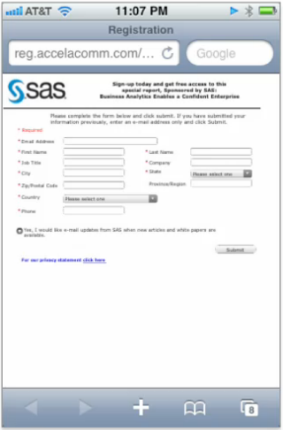
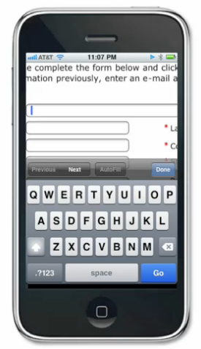
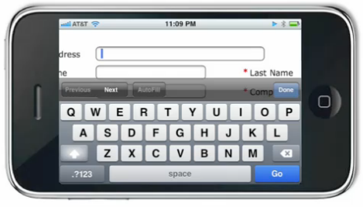
WEB FORM - STRUCTURE
Layout of Forms – Path to Completion
Two column form
Designed for desktop?
Designed for mobile ?
PROBLEM: you can’t see the abel
Source: http://lynda.com

Slide 33
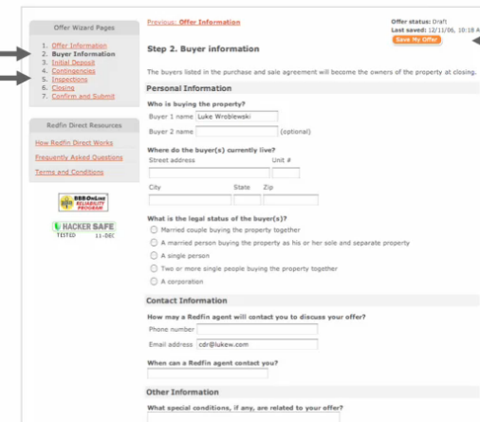
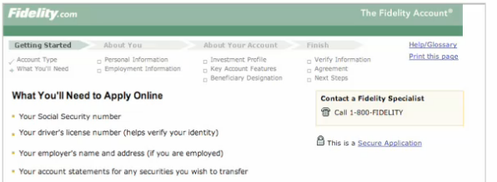
WEB FORM - STRUCTURE
Layout of Forms – Path to Completion
Progress indicators
Forms to show you where you are in the Process
# of steps are pointed out
PROBLEM:
Some will lie
Source: http://lynda.com

Slide 34
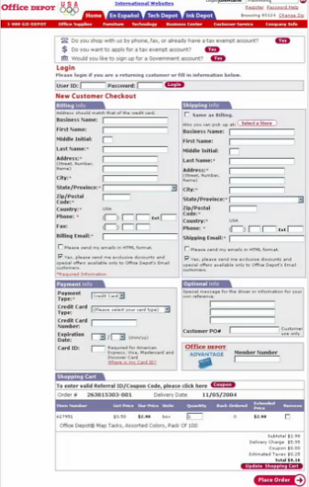
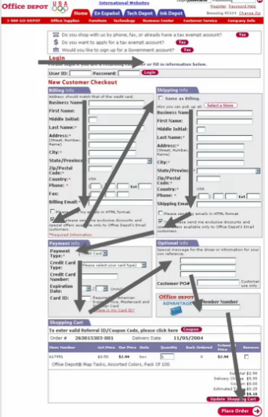
WEB FORM - STRUCTURE
Tabbing between Input Fields
Do you use the mouse to move through Form fields? or thru the keyboard?
Stats: 60% use tabs
Clear path to completion: “tabbing feature”
2 Column Layout
Difficult to know where you are going?
Not good for mobile devices
Code forms:
How people move through fields
Layout in source order (1st, 2nd, 3rd etc. )
Design Layout knowing people will tab through them
Source: http://lynda.com

Slide 35
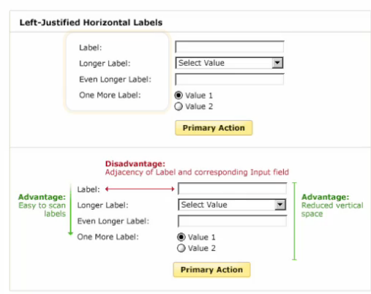
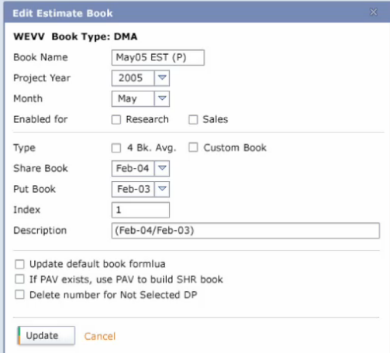
WEB FORM - STRUCTURE
Left- Aligned Layout works well for :
When data required is unfamiliar – take more time to understand what is asked
Can easily scan labels
Less clear association between label and field because of distance
Requires less vertical space
But:
Changing label length may impair layout
Distance between Adjacency of label and corresponding input field
Input Labels
Left-Label Alignment
Source: http://lynda.com

Slide 36
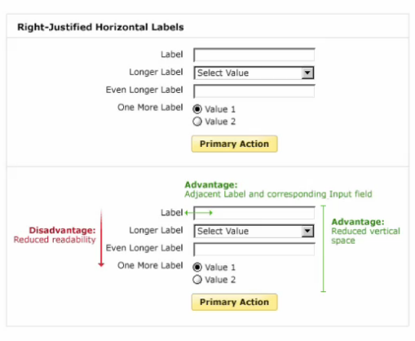
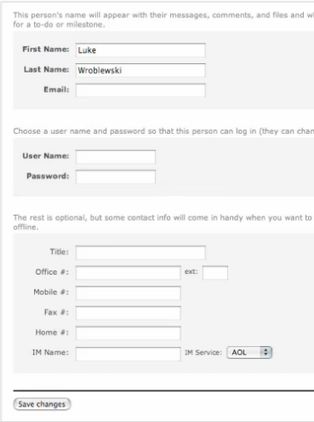
WEB FORM - STRUCTURE
Right- Aligned Layout works well for:
Clear association between label and field because of distance (tight)
Requires less vertical space
But:
More difficult to scan labels because of jag.
Faster completion times 50% faster than left aligned labels Why? Eye Fixation (see later)
Input Labels
Right-Label Alignment
Source: http://lynda.com

Slide 37
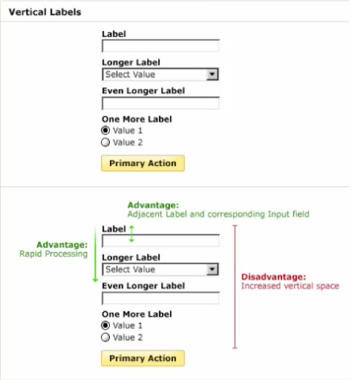

WEB FORM - STRUCTURE
Top- Aligned Layout works well for:
When data being collected is familiar
Even faster completion (left/right aligned)
Easier to code... No tables
Better format for mobile(fits nicer)
But:
Needs more vertical space
Input Labels
Top-Aligned Labels
Source: http://lynda.com

Slide 38
WEB FORM - STRUCTURE
Comparison of Left & Right & Top Aligned
Source: http://lynda.com

Slide 39



WEB FORM - STRUCTURE
Eye Tracking and Filling out Forms
Why is one technique faster than others?
Eye Tracking Studies – Mateo Penzo
Left-Aligned Labels:
A couple of eye movements to make the association with input field and label
Right-Aligned Labels:
Eye fixation is cut in half. Less eye movement
Thus completion – half time
Top-Aligned Labels:
Users can capture both labels and fields with a single eye movement
Thus the fastest of all
Direct Correlation Less Eye Movement → Less time to Complete
Source: http://lynda.com

Slide 40


WEB FORM - STRUCTURE
Forms and Mobile Devices
Left Aligned Labels
Problem with Left-Aligned Form
Cannot see the question
Source: http://lynda.com

Slide 41


WEB FORM - STRUCTURE
Forms and Mobile Devices
Top-Aligned Labels
Field Zoom capability of mobile
Top-Aligned Form
Zooms into field on a smaller screen
So that you can enter
Thus top-Aligned Labels easy
Source: http://lynda.com

Slide 42

WEB FORM - STRUCTURE
INPUT TYPES
Next lecture, we’ll look at designing a form and using all the different
Web Based forms are composed of:
Text field
Text area
Radio button
Checkbox
List/Menu
Hidden
Button
Let’s take a look at the Action buttons specifically
Source: http://lynda.com

Slide 43

FORM - INTERACTION
Actions: Primary and Secondary
Not all actions are equal
Primary: Leads to success -> Save, Continue, Submit
Secondary: Are destructive -> Cancel, Reset, Go Back
Techniques Used:
Primary should be contrasted ie blue vs gray
Secondary should be less apparent ie. Grey button or link, or text links
Source: http://lynda.com

Slide 44

FORM - INTERACTION
Actions: Primary and Secondary
Consider this Destructive Situation
Cancel and Confirm are treated the same (color)
Cancel is first rather than second
Path to Completion
Cancel is greeted first.. Wrong move
Source: http://lynda.com

Slide 45


FORM - INTERACTION
Actions: Primary and Secondary
Which Works Best?
Variations: Look at the primary and secondary buttons
Source: http://lynda.com

Slide 46


FORM - INTERACTION
Actions: Primary and Secondary
Results?
Option B:
Fastest and least amount of fixations (least amount of time parsing it visually)
Both buttons equal..
Option C:
Identical to B – but button contrast
Preferred choice!
It slowed them down just a bit only because they had to parse the information as to what each button represented.. But the best choice!
Source: http://lynda.com
Eye Fixations Tracking: www.etre.com

Slide 47


FORM - INTERACTION
Actions: Primary and Secondary
Results?
Option E:
People failed to complete
Path to completion Hit:Cancel..
Took 6 second longer to complete – didn’t work!
Option F:
Successfully completed but took longer because too far to right
Not preferred
Source: http://lynda.com

Slide 48

FORM - INTERACTION
Actions: Primary and Secondary
Summary:
Align with path to completion Start at the top and linear all the way down
Distinction between buttons ie. Contrast color, link
Primary action first before secondary (lead them to success rather than destruction)
Source: http://lynda.com

Slide 49


FORM - INTERACTION
Source: http://lynda.com
Actions: Primary and Secondary
What happens when a form spans multiple pages:
Which design is the best –let’s analyze it!
Yes or NO?

Slide 50

FORM - INTERACTION
Actions: Primary and Secondary
What happens when a form spans multiple pages:
Look at Top-Aligned model
Summary:
Ensure clear distinction between primary and secondary actions
Align primary actions with input fields → path to completion
Previous and Next – be careful to have them ordered properly
Source: http://lynda.com

Slide 51


FORM - INTERACTION
Once action is taken:
What problems arise once click on Submit?
People click on button ie. Submit
Don’t know what’s happening
Burden on customer
Should be programmed into form
Handle it with:
Disabling (graying it out) the primary button (Post this message, Submit) button to show that their action has been registered
Don’t hide the Submit button
Turn Submit into animation of progress
Benefits:
Avoid duplicate submissions Customer can’t make mistake of double-clicking and resubmitting twice.
List Cases duplicate submissions detrimental?
Source: http://lynda.com

Slide 52

FORM - INTERACTION
What to do with?
Summary:
Move to a single action where they already have agreed through a phrase and move them into the primary action
Legalities of a form
Agree and submit
Agree to privacy policies and terms
Lawyers want an affirmative action
Indicates you agree when check mark
Which is better?
Didn’t check; move to Join Now
Error!! Because they didn’t agree
Look at Button
Clear and precise
Primary and secondary action
Source: http://lynda.com

Slide 53


FORM - INTERACTION
Error Messaging
Something is preventing you from submitting the form
Source: http://lynda.com

Slide 54

FORM - INTERACTION
Error Messaging
How to Resolve Effectively
Clearly communicate error occurred
Place at top to say there are errors on page (strong prominence, bold, color) -> “top placement” needed
Fix It: Provide remedies to correct errors
Associate the field with the error msg (flag it with color)
Enhance the visual of this error (color, bold, contrast)
On Longer Forms, need:
Top placement → error has happened
Field of error needs to be flagged → how to fix it
1,2
3,4
Source: http://lynda.com

Slide 55


FORM - INTERACTION
Inline Validation
What does this mean?
Real-time validation model
Giving feedback instantly as they provide info
Errors displayed instantly when typed not later
Do not need to wait till hitting Submit
Sample Error messages:
Username is taken
Passwords don’t match
Password Strength - meter of strength
Secret answer too short
Birth date invalid
Does not work in following situations?
Name, email, gender and location
Selected userid ID and password (81% noticed it)
Source: http://lynda.com

Slide 56



FORM - INTERACTION
Dynamic Inline Forms
What are dynamic inline Forms?
Expand and collapses a section as filling out a form
Collapses a 5 page form into a 1 page form
Each section is filled once at a time and press Continue
Next section rolls up and previous closes
Errors are inline validation
Source: http://lynda.com

Slide 57

FORM - INTERACTION
Dynamic Inline Forms
Apple Store Example
Sections separated by task
Shipping Details Info
Payment Details
Account
Results:
Faster to complete (online trading/auctions – time sensitive forms)
Struggled with headers.. Thought they need to click on header to continue.. Thus the Continue button in each section.
Source: http://lynda.com

Slide 58

FORM - INTERACTION
Gradual Engagement
What is the problem with this company’s approach ?
Too much time to signup
Committed to joining
Afraid of being bombarded with newsletters, emails etc.
Source: http://lynda.com

Slide 59


FORM - INTERACTION
Gradual Engagement
Gradual Engagment Form?
Alternative to singing-up for services
No need for registration process
People are drawn into new services and products immediately http://www.geni.com/
Benefits:
Try it out without signing up
Test product/service
Successful!
Source: http://lynda.com

Slide 60

FORM - INTERACTION
Geni’s Reply
Gradual Engagment Form Results:
Emailed me
Hooked me in
Account is set up for me
Personable, Friendly
Easy to follow
Lead me to believe – I am getting something free!
Leads into Success Messages
Source: http://lynda.com

Slide 61


FORM - INTERACTION
Success Messages
What does this mean?
No errors on form
Proceeded for successful submission
Must let customer know
Options:
Need to let them know they submitted it successfully (at top a successful message and keeps them on that page)
Provide a totally new page with a thank you and help info, what’s next.
ALWAYS email them results
Source: http://lynda.com

Slide 62
FORM – Building a Form
Next Lecture
Learn how to build a Form
Input buttons
Processing the Form
Talk about storing the results
Emailing with results
Captchas feature to avoid spamming
Source: http://lynda.com

